Slide 1
Socket.io

Slide 2
Introduction
Socket.IO is a JavaScript library for real-time web applications.
It enables real-time, bi-directional communication between web clients and servers.
It has two parts
a client-side library that runs in the browser
a server-side library for Node.js
Both components have a nearly identical API.

Slide 3
Introduction contd.
License: MIT License
Written in: JavaScript
Stable release: 2.3.0 / September 20, 2019
Original author: Guillermo Rauch
Developer: Automattic

Slide 4
Real-time Applications
Instant messengers − Chat apps like Whatsapp, Facebook Messenger, etc. You need not refresh your app/website to receive new messages.
Push Notifications − When someone tags you in a picture on Facebook, you receive a notification instantly.
Collaboration Applications − Apps like Google Docs, which allow multiple people to update same documents simultaneously and apply changes to all people's instances.
Online Gaming − Games like Counter Strike, Call of Duty, etc., are also some examples of real-time applications.

Slide 5
Event Handling in Socket.io: Server Side
Sockets work based on events. There are some reserved events, which can be accessed using the socket object on the server side.
Connect
Message
Disconnect
Reconnect
Ping
Join and
Leave

Slide 6
Event Handling in Socket.io: Client Side
The client-side socket object also provides us with some reserved events:
Connect
Connect_error
Connect_timeout
Reconnect, etc.

Slide 7
Real-time Chatting Application
With sockets, when the server receives a new message it will send it to the client and notify them.
It is bypassing the need to send requests between client and server.
A simple chat application shows how this works.

Slide 8
Explanation
We will be using express to build the web server that Socket.IO will work with.
ExpressJS makes it easy to define routes and other things.
The data will be stored in a database which will be created using MongoDB and Mongoose.
Main frameworks used in the application:
ExpressJS
Node.js
Socket.io

Slide 9
Implementation: app.js
//require the express module
const express = require("express");
const app = express();
const dateTime = require("simple-datetime-formater");
const bodyParser = require("body-parser");
const chatRouter = require("./route/chatroute");
const loginRouter = require("./route/loginRoute");
//require the http module
const http = require("http").Server(app);
// require the socket.io module
const io = require("socket.io");
const port = 3000;

Slide 10
Implementation: app.js
//setup event listener
socket.on("connection", socket => {
console.log("user connected");
socket.on("disconnect", function() {
console.log("user disconnected");
});
//Someone is typing
socket.on("typing", data => {
socket.broadcast.emit("notifyTyping", {
user: data.user,
message: data.message
});
});
//when someone stops typing
socket.on("stopTyping", () => {
socket.broadcast.emit("notifyStopTyping");
});

Slide 11
Implementation: app.js
socket.on("chat message", function(msg) {
console.log("message: " + msg);
//broadcast message to everyone in port:5000 except yourself.
socket.broadcast.emit("received", { message: msg });
//save chat to the database
connect.then(db => {
console.log("connected correctly to the server");
let chatMessage = new Chat({ message: msg, sender: "Anonymous" });
chatMessage.save();
});
});
});
});

Slide 12
Implementation: dbconnect.js
Setting up connection to the database for saving and retrieving messages.
const mongoose = require("mongoose");
mongoose.Promise = require("bluebird");
const url = "mongodb://localhost:27017/chatApp";
const connect = mongoose.connect(url, { useNewUrlParser: true });
module.exports = connect;

Slide 13
Implementation: chat.js
var socket = io();
var messages = document.getElementById("messages");
(function() {
$("form").submit(function(e) {
let li = document.createElement("li");
e.preventDefault(); // prevents page reloading
socket.emit("chat message", $("#message").val());
messages.appendChild(li).append($("#message").val());
let span = document.createElement("span");
messages.appendChild(span).append("by " + "Anonymous" + ": " + "just now");
$("#message").val("");
return false;
});

Slide 14
Implementation: chat.js
// fetching initial chat messages from the database
(function() {
fetch("/chats")
.then(data => {
return data.json();
})
.then(json => {
json.map(data => {
let li = document.createElement("li");
let span = document.createElement("span");
messages.appendChild(li).append(data.message);
messages
.appendChild(span)
.append("by " + data.sender + ": " + formatTimeAgo(data.createdAt));
});
});
})();

Slide 15
Implementation: chat.js
//is typing...
let messageInput = document.getElementById("message");
let typing = document.getElementById("typing");
//isTyping event
messageInput.addEventListener("keypress", () => {
socket.emit("typing", { user: "Someone", message: "is typing..." });
});
socket.on("notifyTyping", data => {
typing.innerText = data.user + " " + data.message;
});
//stop typing
messageInput.addEventListener("keyup", () => {
socket.emit("stopTyping", "");
});
socket.on("notifyStopTyping", () => {
typing.innerText = "";
});

Slide 16
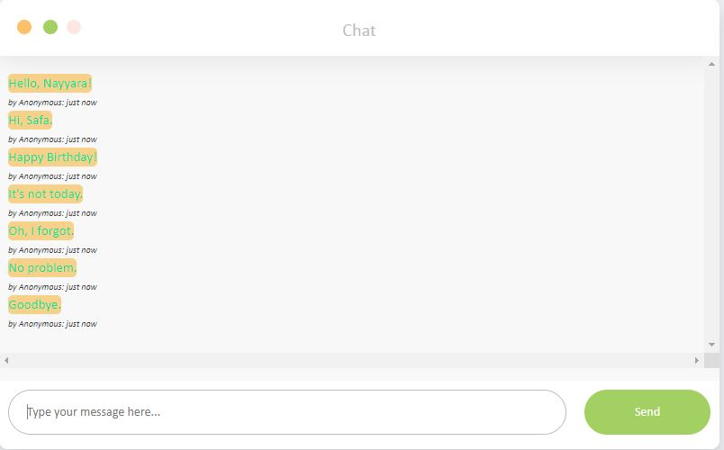
Results (1)

Slide 17
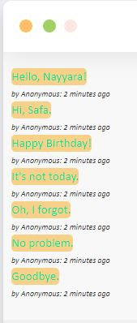
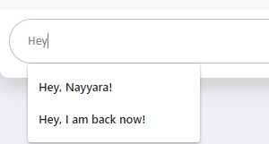
Results (2)
Allows predictive text facility.
Keeps updating time.
Saves all messages.
Shows when someone is typing.

Slide 18
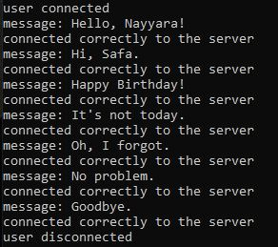
Results (3)

